Slide 1
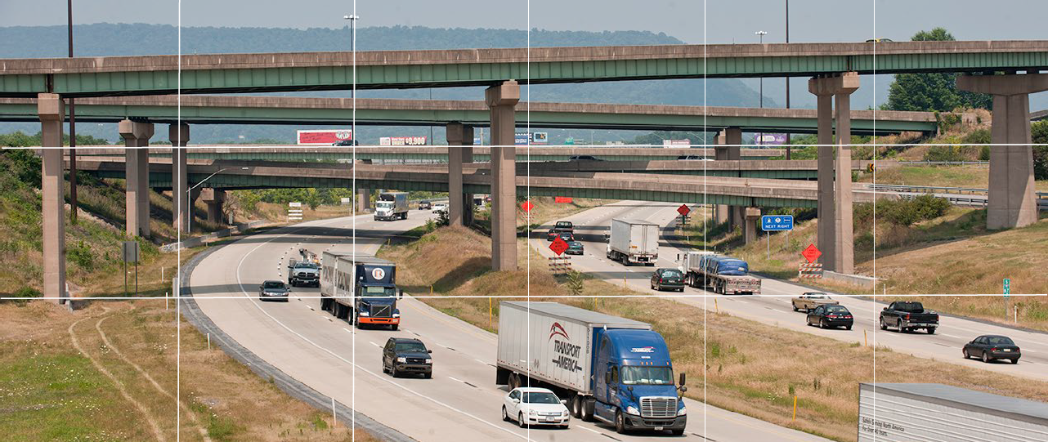
I-81 and I-78 Alternative Fuels Deployment Plan
Kickoff Meeting
January 6, 2020

Slide 2
Agenda
Welcome and Introductions
Background on Alternative Fuel Corridors
Context with Other Commonwealth Initiatives
Project Study Overview
Corridor Data and Gaps
Discussion on Potential for Partnerships
Conclusions and Next Steps

Slide 3
Background on
Alternative Fuel Corridors

Slide 4
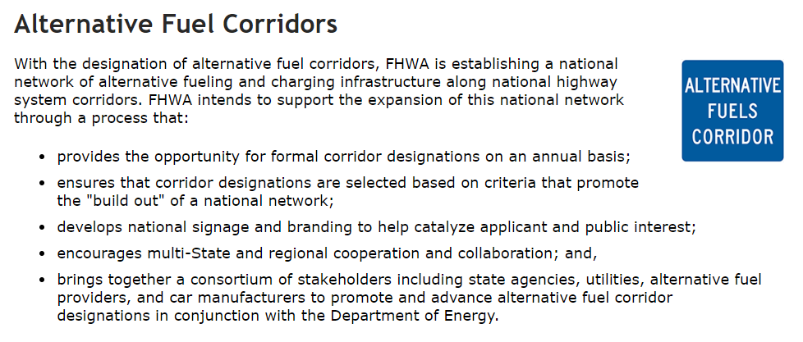
Alternative Fuel Corridors Program
https://www.fhwa.dot.gov/environment/alternative_fuel_corridors/

Slide 5
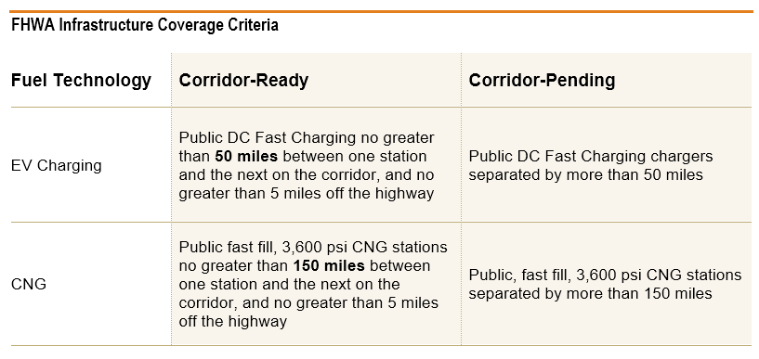
Corridor Criteria
Cannot include Tesla Chargers

Slide 6
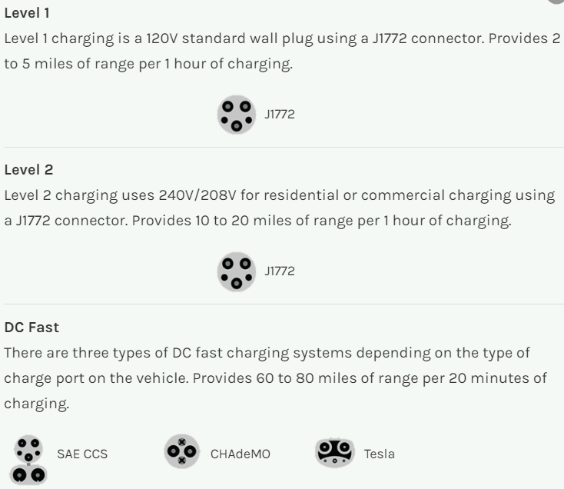
Charging Levels

Slide 7
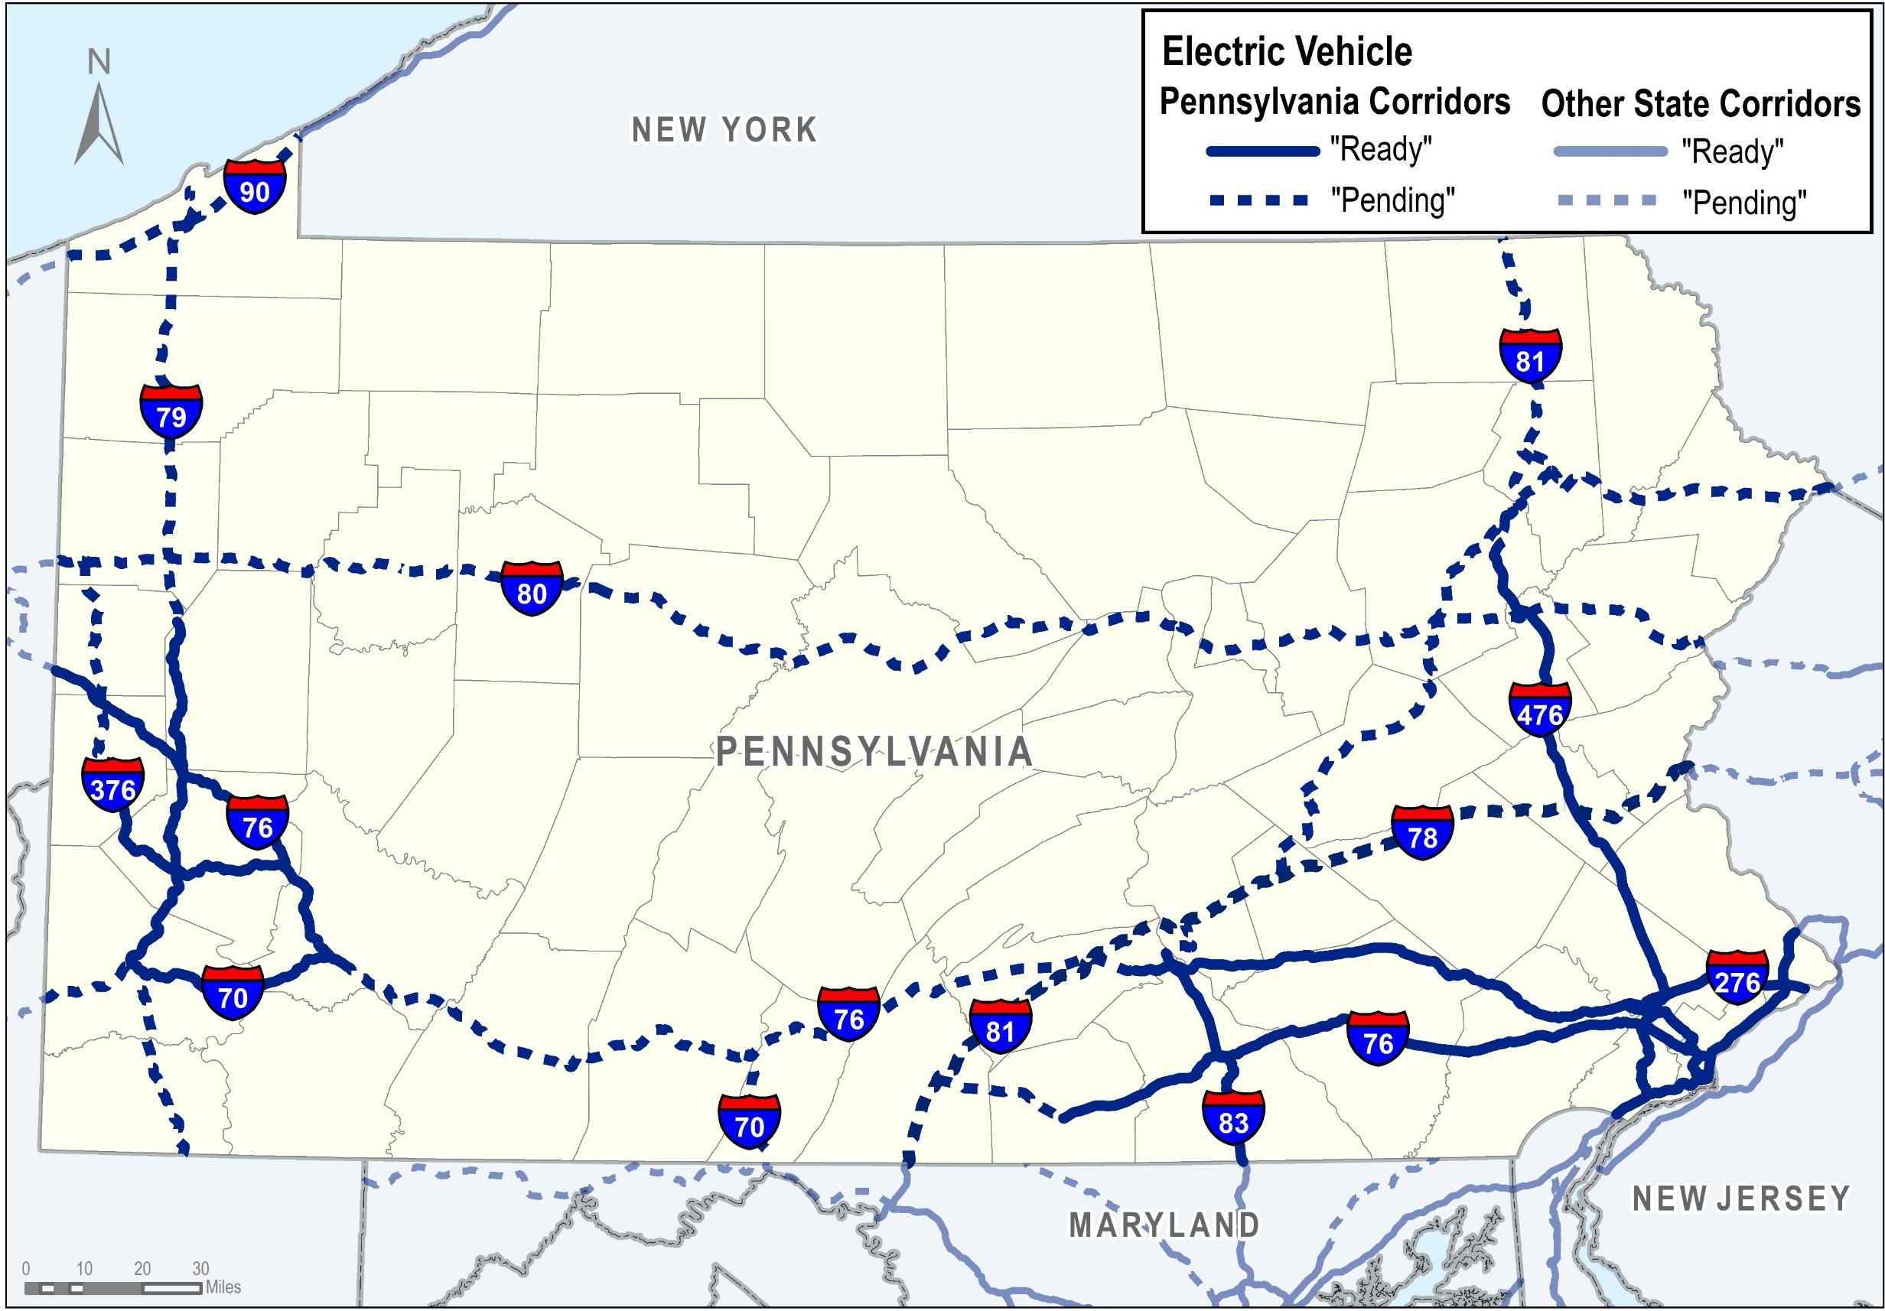
Electric Vehicle Corridors

Slide 8
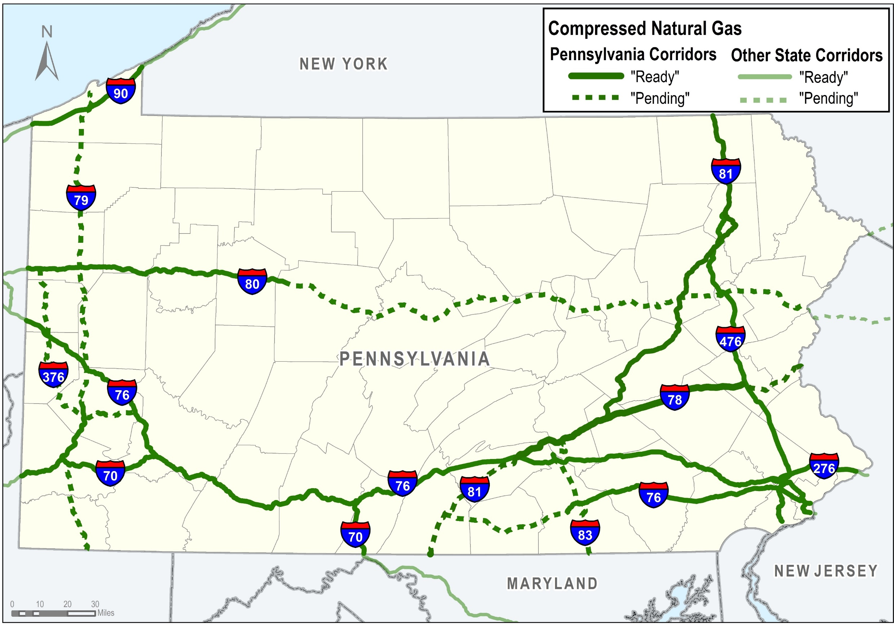
CNG Corridors

Slide 9

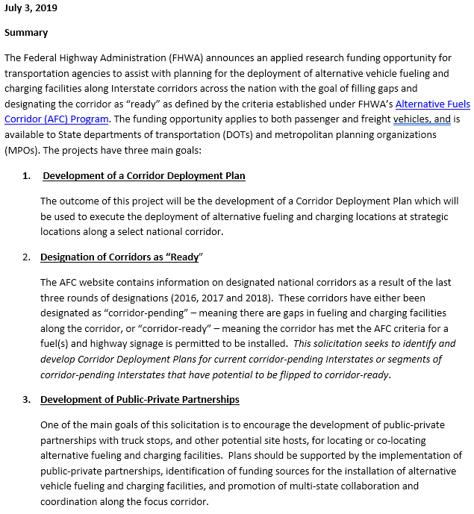
FHWA Funding for Deployment Plans
Solicitation for Alternative Fuels Corridor Deployment Plans

Slide 10
Context With Other
Commonwealth Initiatives

Slide 11
Related Initiatives
Driving Electric Pennsylvania Coalition
Pennsylvania FAST Act Corridor Infrastructure Grant
PennDOT Private-Public-Partnership Trillium (CNG)
Pennsylvania Turnpike Commission (PTC) Alternative Fueling Stations
Alternative Fuels Incentive Grant (AFIG)
PennDOT Signage and Pennsylvania Tourism Signing Trust
Transportation and Climate Initiative (TCI)
Clean Vehicles and Fuels Workgroup
Pittsburgh and Philadelphia Region Clean Cities
Pennsylvania Electric Vehicle Roadmap
Driving PA Forward (VW Mitigation Funding)
Proposed SB 596
Link to PA Electric Vehicle Roadmap:
Link to DEP AFIG Program:
http://files.dep.state.pa.us/Energy/OfficeofPollutionPrevention/StateEnergyProgram/PAEVRoadmap.pdf
https://www.dep.pa.gov/Citizens/GrantsLoansRebates/Alternative-Fuels-Incentive-Grant/Pages/default.aspx

Slide 12
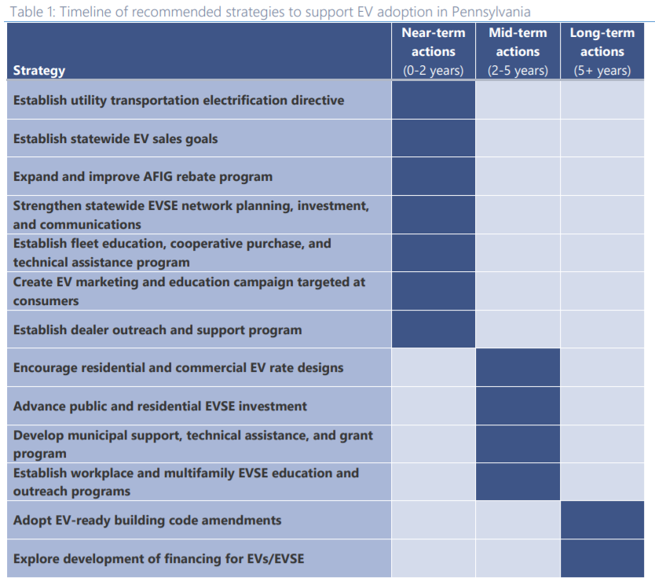
Roadmap Recommended Strategies
EVSE = Electric Vehicle Supply Equipment

Slide 13
Project Study Overview
(Evaluating Roles and Responsibilities)

Slide 14
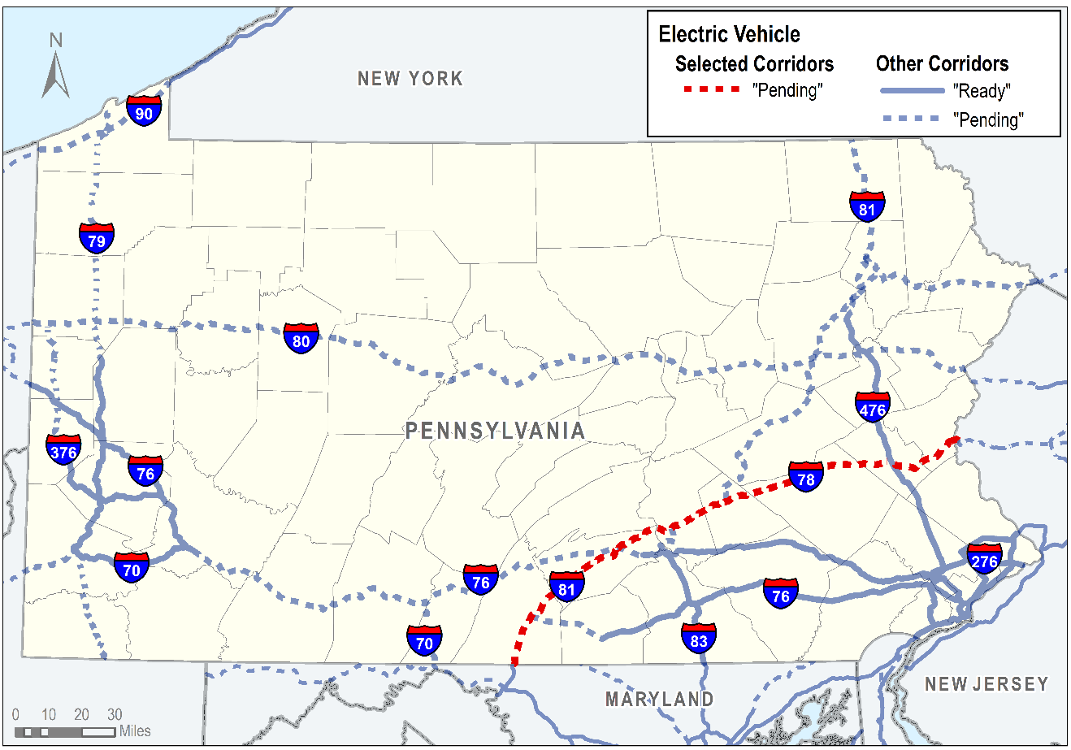
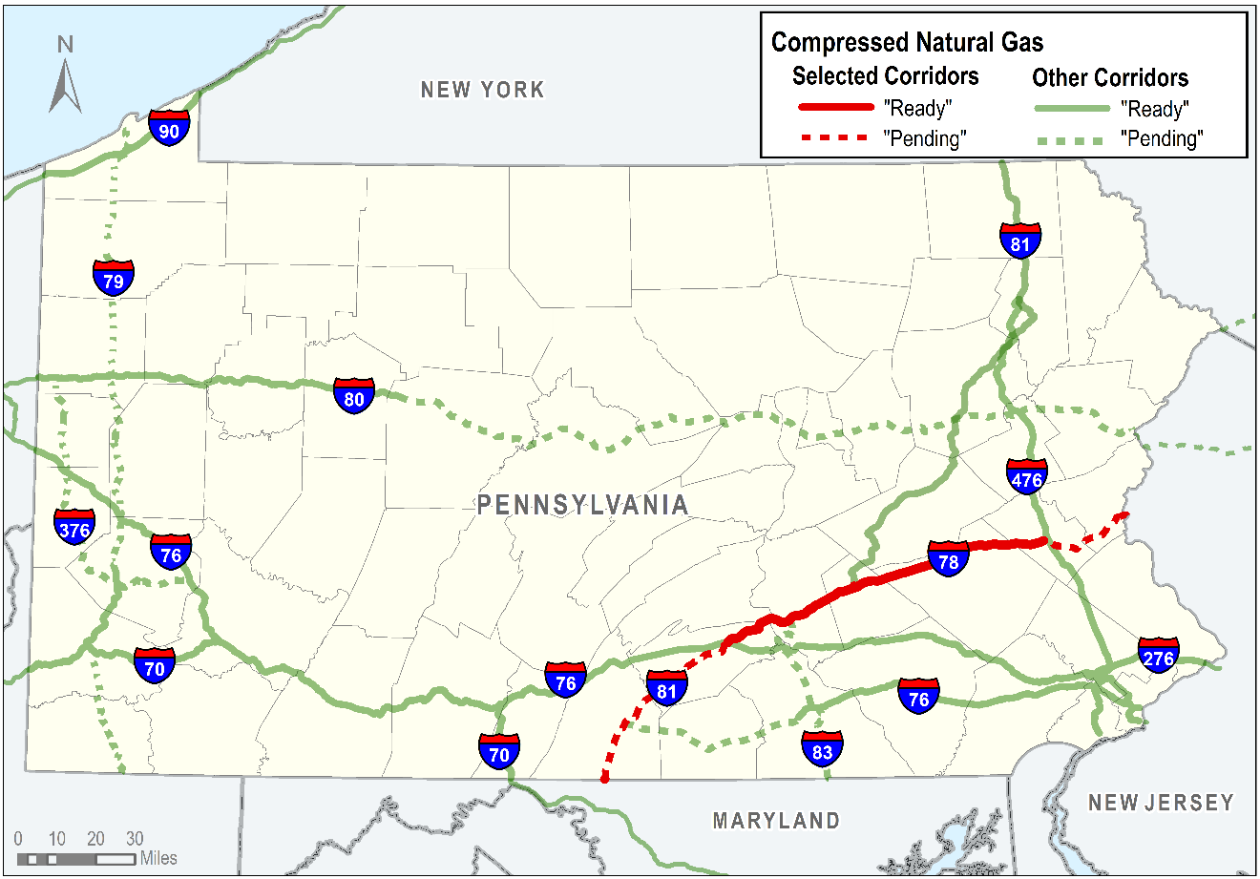
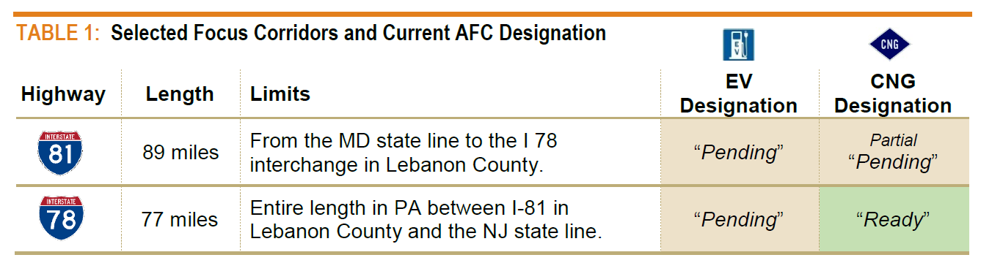
Project Focus

Slide 15
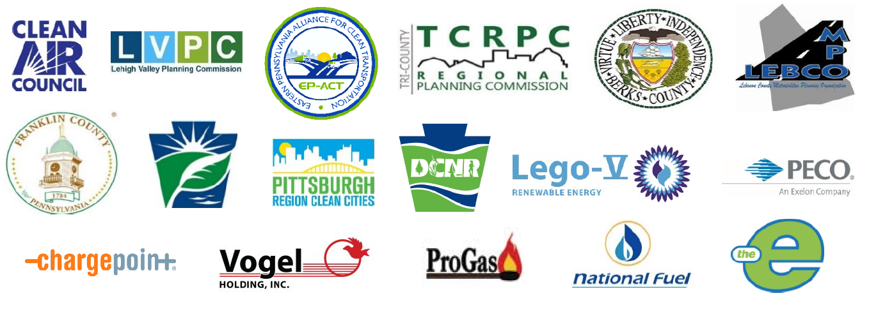
Project Tasks
Task 1:
Project Team Kickoff
Project Kickoff Meeting to review scope, goals, objectives and work plan.
Assessment and discussion of corridor data needs.
Identify roles and evaluate additional tasks.

Slide 16


Project Tasks
Task 2:
Baseline Assessment
Evaluate current alternative fuel infrastructure within the corridor. Identify key gaps where additional infrastructure is needed to support “Ready” designation.
Assess current travel characteristics including origins and destinations of both autos and trucks using the corridors.
Evaluate alternative refueling development potential along the corridor. Assess potential future corridor development and traffic increases using information from travel models, MPO land use forecasts, and property data.
Coordinate with utilities to ensure that sufficient infrastructure is available to support alternative fuel infrastructure within the corridor.
Coordinate and review alternative fuel infrastructure applications received through the PaDEP Alternative Fuel Incentive Grant (AFIG) and Driving PA Forward programs.
Evaluate and assess current signing and policies related to alternative fuel infrastructure locations.
Summarize and review PaDEP grant opportunities and information in the recent Pennsylvania Electric Vehicle Roadmap.

Slide 17
Project Tasks
Task 3:
Outreach and Engagement
Identify key stakeholders and work to identify the potential for private partnerships within the corridor.
Conduct targeted outreach to specific commercial and municipal fleets to determine interest in alternative fuels, needs and other relevant issues.
Conduct up to 3 workshops with the identified stakeholders to discuss potential for partnerships and assess potential site locations. The workshops can include a review of the Baseline Assessment results.
Discuss potential marketing strategies to the public to increase awareness of alternative refueling locations and increase alterative vehicle usage.
Discuss funding opportunities and grant programs to support infrastructure development.

Slide 18
Project Tasks
Task 4:
Site Feasibility Assessment
Affirm and assess information obtained and summarized in Task 1 and Task 2.
Prioritize identified future refueling locations based on the established criteria.
Complete a planning level environmental screening process for the site locations using available GIS environmental data layers.
Review regional and local zoning and other relevant plans to assess site potential.
Evaluate the costs and benefits of delivering electricity from the grid versus on site generation from solar or an onsite generator.
Conduct targeted outreach to MPOs, townships and private companies to discuss highly ranked sites in order to identify other implementation issues.

Slide 19
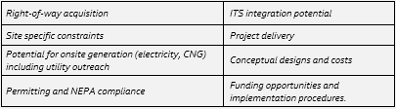
Project Tasks
Task 5:
Preparation of Action Plan
Assess with project stakeholders the key elements needed to ensure development of target sites. Identify key steps and constraints.
Identify non-federal cost-share and fund development opportunities.
Discussion of procedures to address remaining barriers.
Identify key roles for stakeholders to ensure implementation.
Develop a Final Action Plan document that summarizes key steps to obtain future funding and to ensure project implementation.

Slide 20
Project Tasks
Task 6:
Case Study Activities
Provide a 2-5 page summary of the project tasks and conclusions.
Develop a lessons learned summary that highlights the key challenges, issues and barriers encountered during the study.
Coordination with FHWA staff.
Project Duration: January – November 2020

Slide 21
Corridor Data and Resources

Slide 22
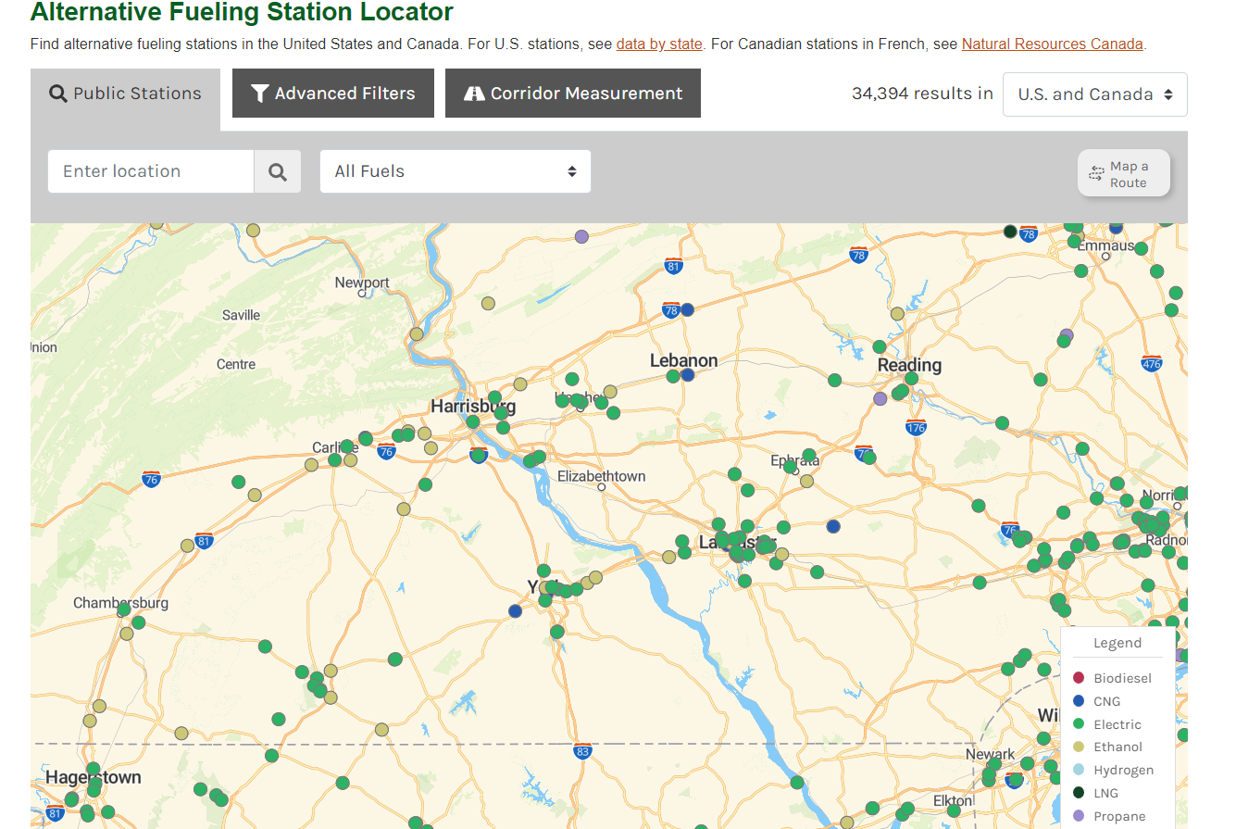
Available Data
https://afdc.energy.gov/stations#/find/nearest

Slide 23
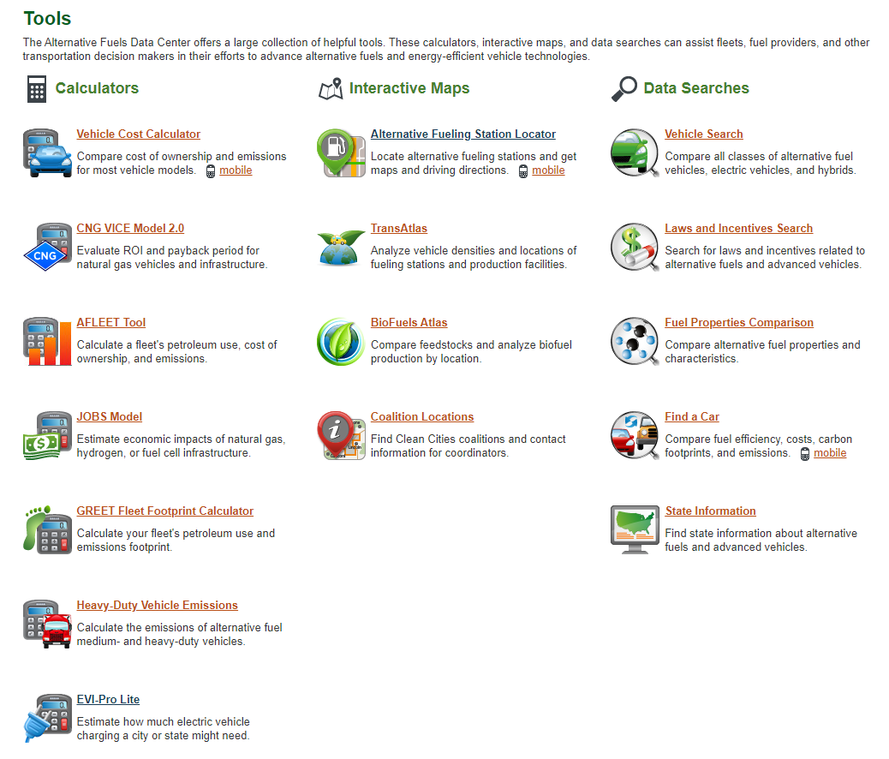

Available Tools
http://altfueltoolkit.org/materials/helpful-tools-for-alternative-fuel-corridor-planning/?portfolioCats=581
https://afdc.energy.gov/tools

Slide 24
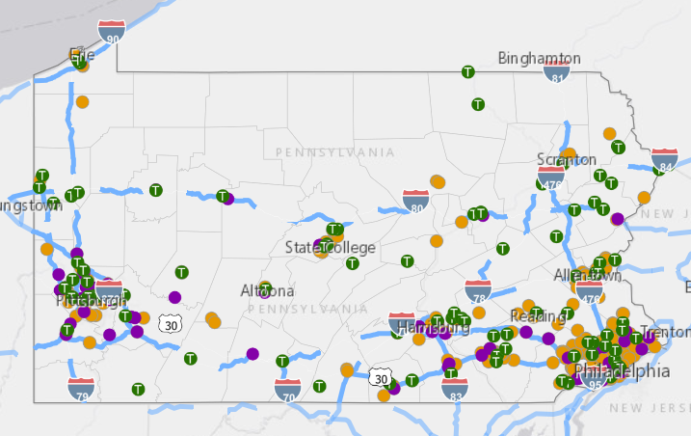
Existing EV Stations
PennDOT Map Under Development

Slide 25
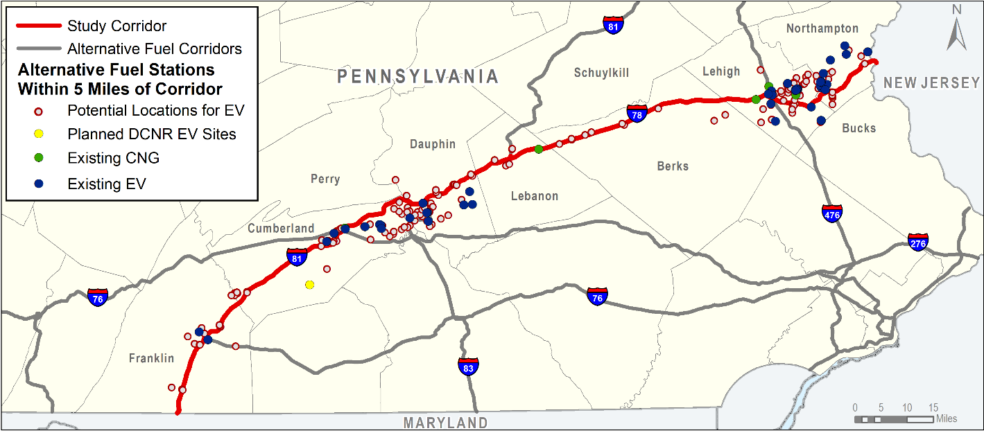
Existing and Potential EV-CNG Stations
> Level 1
Interactive Map Under Development
https://tmp-map.s3.amazonaws.com/dot/alt-fuel/i81-i78-alt-fuel.html

Slide 26
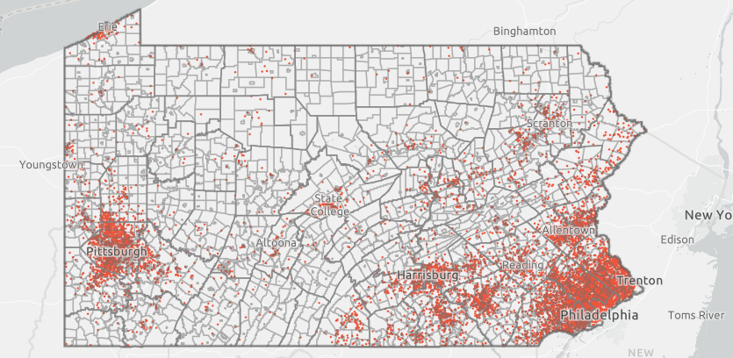
DVRPC Map of Registered EVs
Map uses VIN decoded PennDOT registration data from December 2017. Select “PEV Distribution (PA)” tab.
https://tinyurl.com/DVRPC-EV-Toolkit

Slide 27
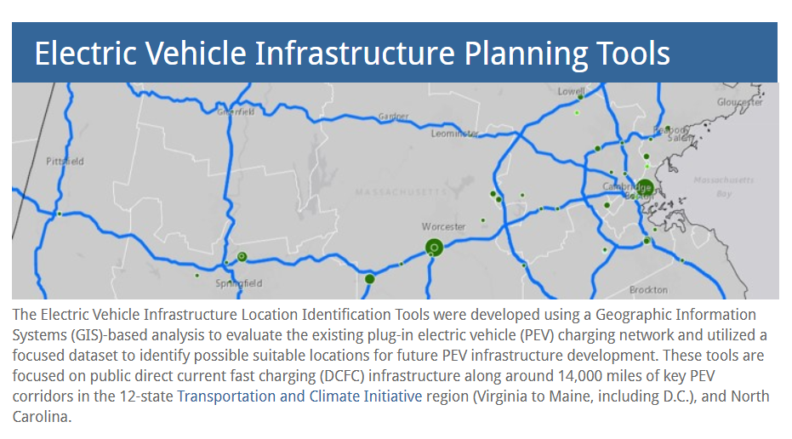
MJ Bradley & Assoc. Tool
https://www.mjbradley.com/mjb_form/EV-tools

Slide 28
Examples of Stations Along Corridor
Owner | Mile Marker | Address | Distance From Exit | Fuel
Clean Energy Carlisle Flying J | I-81 Mile 52 | 1501 Harrisburg Pike, Carlisle, PA 17013 | < 1 mile | CNG
Sheetz | I-81 Mile 52 | 1098 Harrisburg Pike, Carlisle, PA 17013 | 2.1 mile | EV 4-outlets (Electrify America)
GAIN Clean Fuel | I-78 Mile 6 | 1725 Legionnaire Drive, Fredericksburg, PA | < 1 mile | CNG
Uni-Mart Exxon | I-78 Mile 53 | 825 Route 309, Allentown, PA 18104 | 2.7 mile | CNG

Slide 29
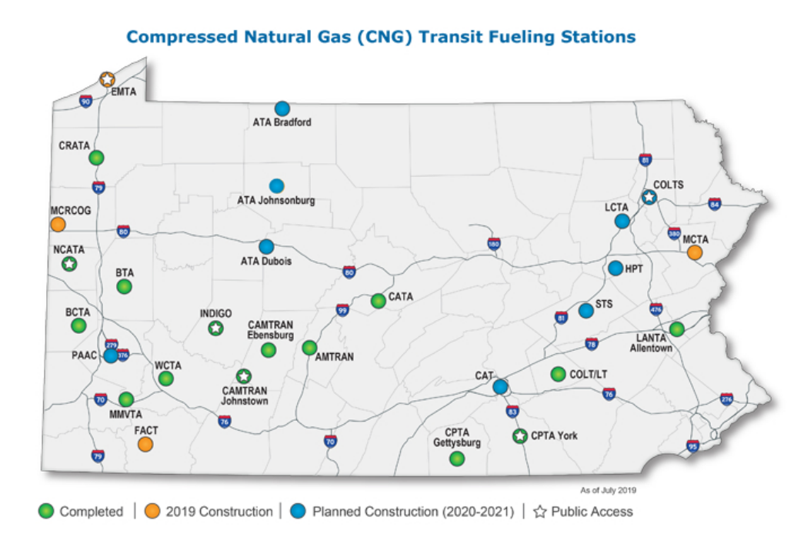
PennDOT P3 CNG Stations

Slide 30
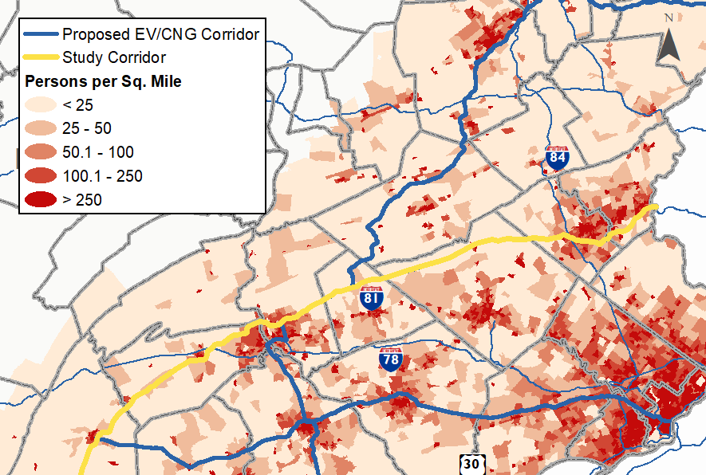
Population Density Along Corridor

Slide 31
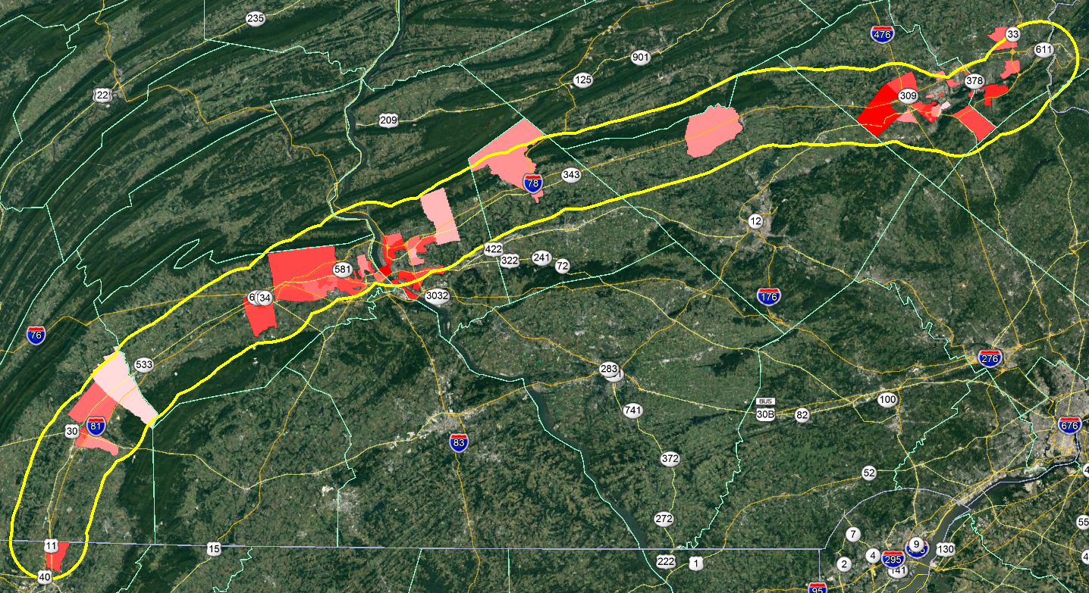
Highest Job Locations Along Corridor

Slide 32
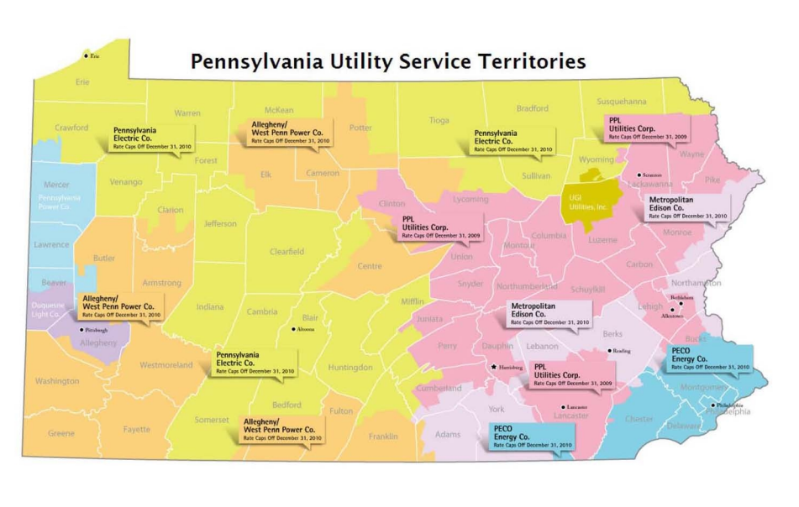
Power Supply Agencies in Corridor

Slide 33
Electric Supply Grid

Slide 34
Discussion on Potential for Partnerships

Slide 35
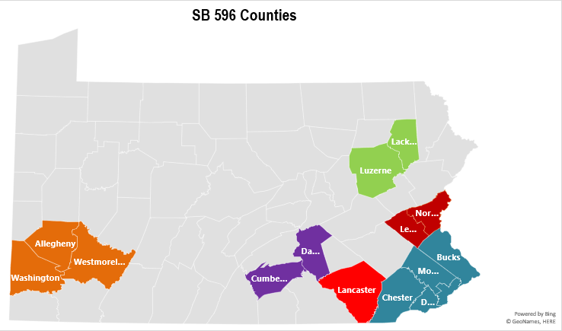
Pennsylvania Examples
SB 596
In order to increase access to public and residential EV infrastructure, SB 596 would require utility companies serving some counties to create transportation electrification infrastructure development plans.
https://www.legis.state.pa.us/CFDOCS/Legis/PN/Public/btCheck.cfm?txtType=HTM&sessYr=2019&sessInd=0&billBody=S&billTyp=B&billNbr=0596&pn=1343

Slide 36
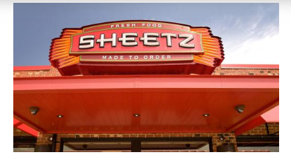
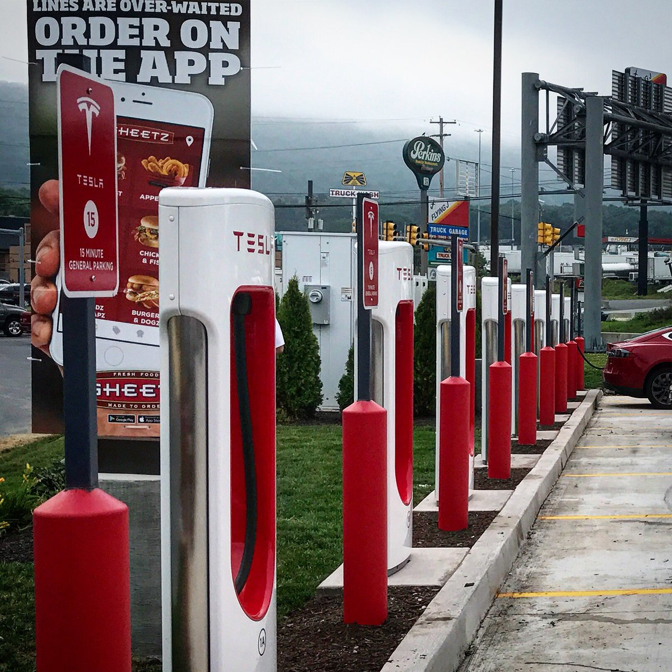
Pennsylvania Examples
Breezewood Tesla Superchargers
The convenience store has has 21 locations with Tesla Superchargers. Sheetz also has different types of chargers at other locations including Electrify America charging stations in Carlisle and Bloomsburg.

Slide 37


Pennsylvania Examples
https://www.dvrpc.org/Reports/12055A.pdf
Turnpike stations were jointly funded by a grant from Pennsylvania DEP to Car Charging Group, a private company, with contributions from the Turnpike Commission. This partnership demonstrates the potential for public-private partnerships to enable charging station deployment.

Slide 38
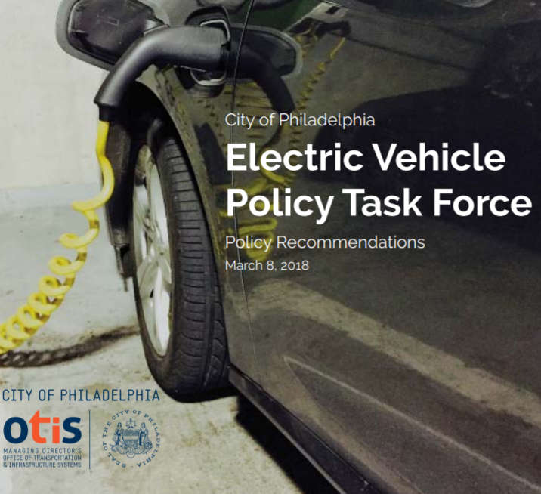
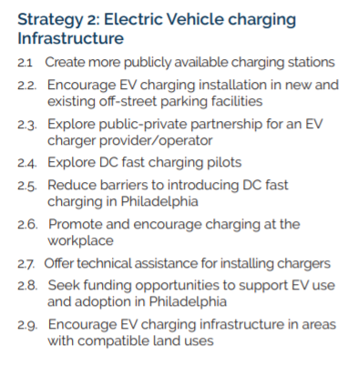
Pennsylvania Examples
http://www.phillyotis.com/wp-content/uploads/2018/03/Electric-Vehicle-Policy-Task-Force-Final-Report.pdf

Slide 39

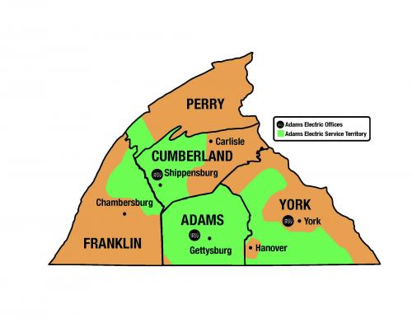
Pennsylvania Examples
Adams REC is an electricity cooperative providing electricity services to five south central PA counties. A section of their website is devoted to providing information about EVs and their benefits.
https://www.adamsec.coop/content/my-ev

Slide 40

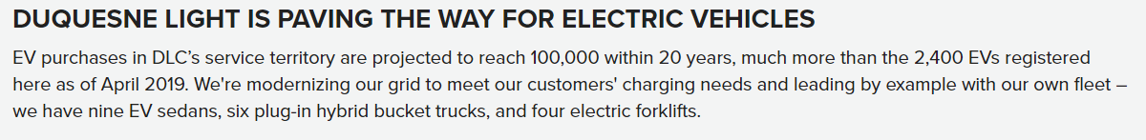

Pennsylvania Examples
https://www.utilitydive.com/news/the-keystone-state-may-have-found-the-key-to-the-next-wave-of-transportatio/545008/
PECO has announced incentives for commercial customers who install EV-charging stations for public use. The incentive will be available to any commercial customer who receives funding under the Pennsylvania Department of Environmental Protection's "Driving PA Forward" program.
Other Examples?

Slide 41

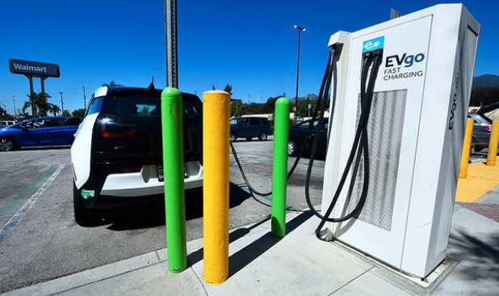
Review of Other State Partnerships
States looking into Public-Private Partnership:
  Washington
  Florida
  New York
  Oregon
  Maryland
  Michigan
  New Jersey
  California
  Massachusetts
Greenspot working with towns and cities to create “e-mobility hubs” – locations that combine charging stations for public use and electric vehicle carsharing.

Slide 42
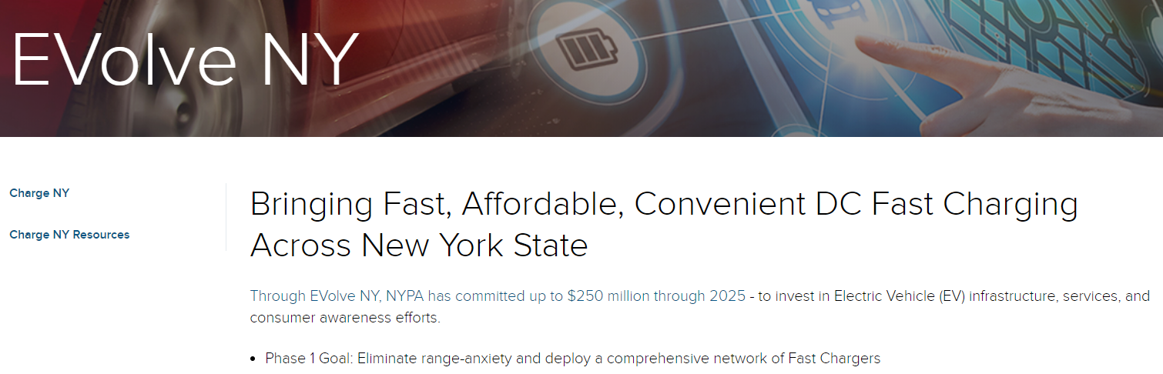
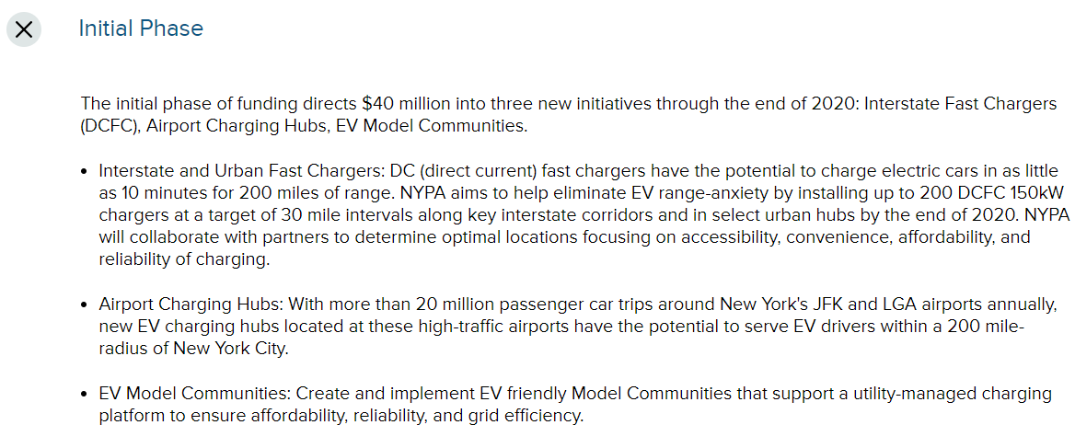
New York Example

Slide 43
Next Steps

Slide 44
Upcoming Steps
Winter 2020: Collaboration & data gathering
March 2020: Project outreach at Drive Electric PA meeting
Spring – Summer 2020: Additional workshops on partnership opportunities
Spring – Summer 2020: Informational sharing among deployment plan areas
Fall 2020: Potential in-person meeting to report recommendations
Fall 2020: Public website or public outreach

Slide 45
Project Lead
Ngani Ndimbie | Executive Policy Specialist
PA Department of Transportation
400 North Street, 8th Floor | Harrisburg, PA 17120
Phone: 717.857.3209 | Mobile: 717.836.6570
E-Mail: nndimbie@pa.gov

